Slide 1
Internet giants: private regulation and new gatekeepers
Gustavo Gómez, OBSERVACOM
IAMCR 2019 - Madrid, July 8- 2019

Slide 2
Facilitators of freedom of expression
Positive rol of the intermediaries
Never before there were fewer obstacles to create and publish content (for the "connected")
Never before there has been so much availability and diversity of content to search and receive information
Success of the Internet requires the presence of intermediaries to access the "inhuman" volume of information available
Intermediaries are key actors for the exercise of freedom of expression and the right to information on the Internet

Slide 3
Internet control points
The current development of the Internet has placed platforms in a key role to promote/limit access to information and expression
Frank La Rue (former UN Rapporteur on Freedom of Expression): "Due to the position they hold and the role they play, intermediaries have established as point through which it is technically possible to exercise control over Internet content”
Platforms are pressured by governments to exercise surveillance and censorship.
Therefore, protection for intermediaries is needed…

Slide 4
Private regulation of public spaces
Negative rol of the intermediaries
Increasing intervention of big platforms in the free flow of expressions and content on the Internet, both by govrernamental pressure, and by its own decision (content moderation)
Content platforms are new public spaces and are no longer "mere technical roads" but a new type of “publishers" (not like media)
New dimension of the concept of "access": not only production or publication of content, but its visibility and effective availability

Slide 5
Gatekeepers of public discourse
Prioritization of information, ideas and opinions, by own decision
Fragmentation of the public debate (bubble effect), by own decision
Removal, de-indexing or blocking of content
  by State pressure and other private actors
  by own decision
Account locking or profile deletion
  by State pressure and other private actors
  by own decision

Slide 6
State censorship and private censorship
Current UN Rapporteur on Freedom of Expression, David Kaye:
"It’s common for private companies to censor, monitor, or otherwise restrict freedom of expression, usually pressured by governments, but sometimes on their own initiative"

Slide 7
Concentration + Gatekeepers
Its role as gatekeepers is worsen by the concentration of power in a few international corporations in the Internet content layer.
Several of the corporations with a dominant position on the Internet own platforms that enable the free flow of information and expressions: social networks, search engines, messaging and video sharing platforms
Concentration erodes free competition but also affects freedom of expression and represents a serious risk for a free and open Internet. It is no longer the Internet we dream of.

Slide 8
Intemediarie liability and private police
Concern for legal initiatives to regulate content that require platforms to be judges or private police on third-party content
But also the platforms are judges or private police by their own decision (moderation by the application of terms of service - TOS).
Their algorithms and moderators decide what is "inappropriate" or "violent”, p.e.
Without transparency, without due process, without the right to defense and with TOS that violate human rights standards

Slide 9
Corporate self-regulation or abusive regulation?
We are caught in a deceptive and dangerous polarization. We have to build a third way. Neither Silicon Valley, Nor China ... Nor Europe?
Self-regulation must exist, but it can’t be the only way to go.
And we must also continue to reject authoritarian or abusive legislation.
But the enormous power of large content platforms requires democratic societies to set limits to guarantee rights and freedoms on the Internet, as well as the predominance of general and public interest.

Slide 10
Smart regulation: limits to platforms without violating freedom of expression
It is necessary (and possible) to build a democratic regulation that ensures adequate environments to protect users from the power of large platforms and guarantee a free and open Internet.
A respectful regulation compatible with international Human Rights standards that also consider the existing asymmetries between different platforms and services.

Slide 11
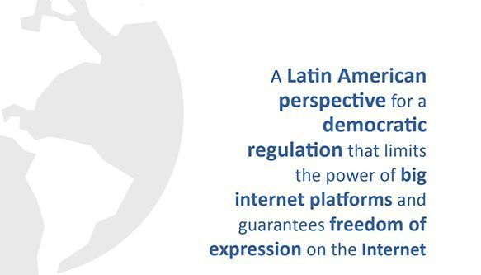
see at: www.observacom.org

Slide 12
Gustavo Gómez
Director Ejecutivo
OBSERVACOM
Observatorio Latinoamericano
de Regulación, Medios y Convergencia
direccion@observacom.org

